Slide 1

Genetic Algorithm: benchmark
Group 2: Jannik Wirtz & Shyngyskhan Abilkassov

Slide 2

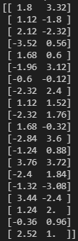
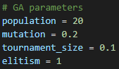
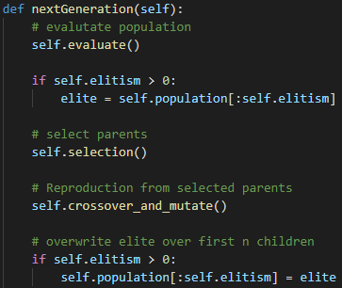
Genetic Algorithm
Genome: 2D-array of limited precision floats
Population: 20 candidates
Fitness: negated Rosenbrock/Rastrigin function value
Initialization: random real numbers in range with limited step-precision
Tournament selection: with 10% of population (2)
+ elitism (keeping the most fit individual)
Crossover: 1st Child: Arithmetic average
2nd Child: Randomly picking gene values from one of the 2 parents
Mutation: 20% Chance for each gene of child to
increase or decrease value (normal distr.)
Generations: 20
Stop criteria: none, (could have stopped after max fitness plateaus for 5 generations)

Slide 3
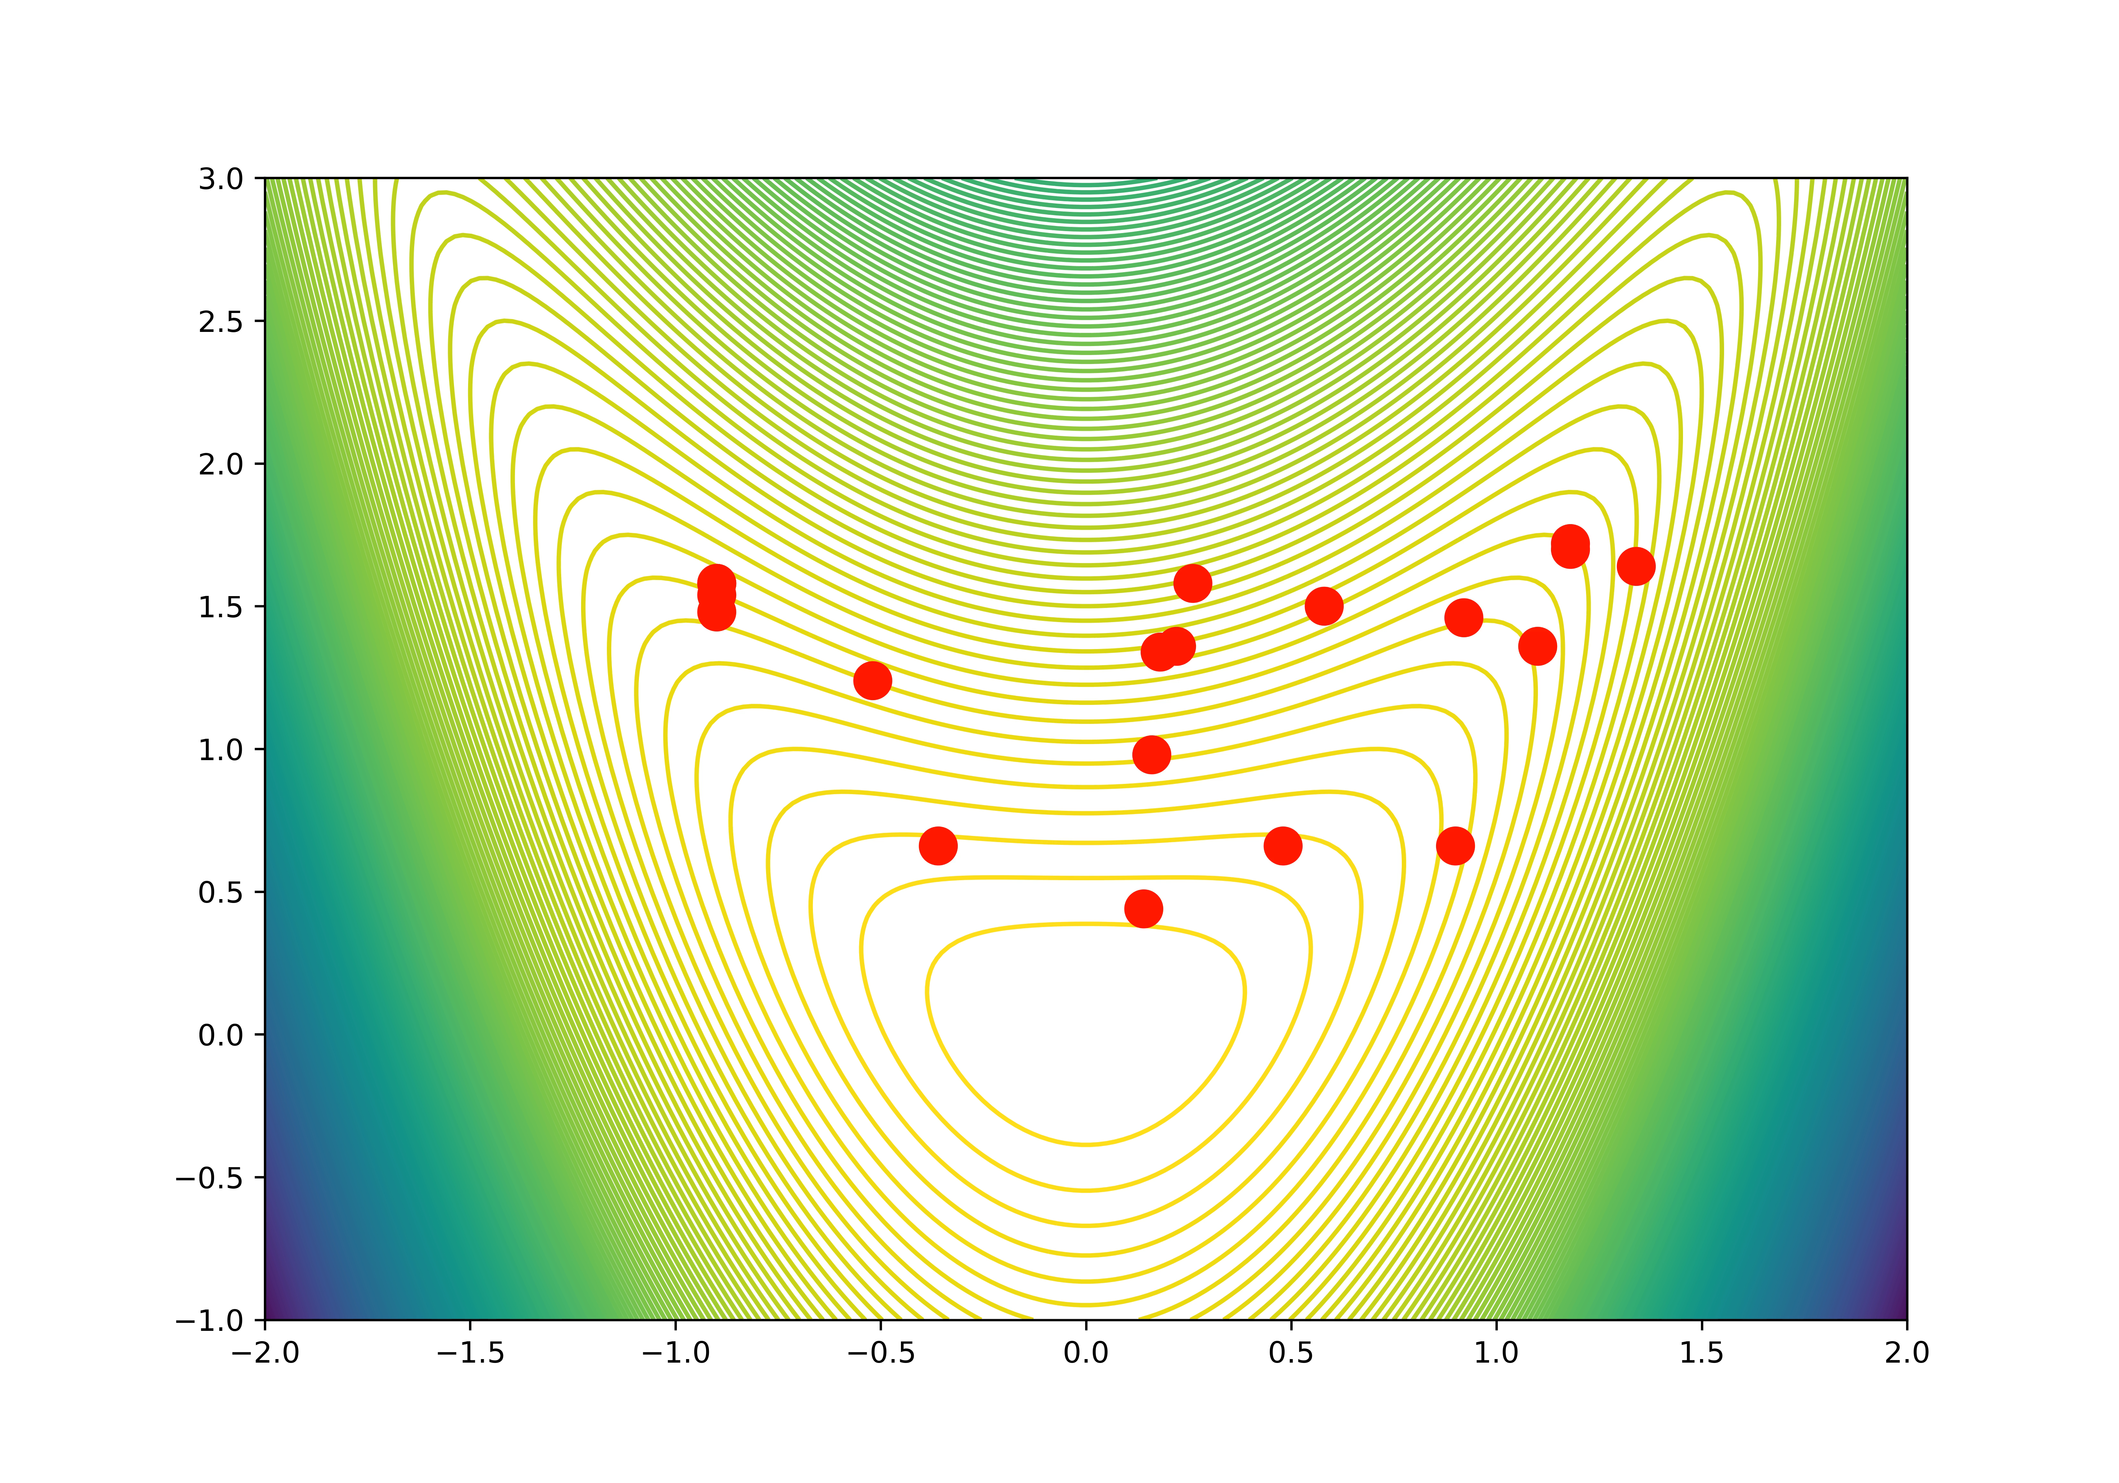
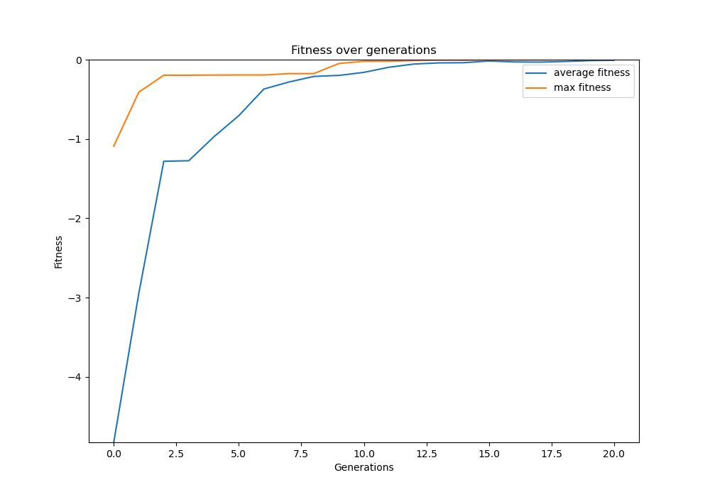
Genetic Algorithm: Rosenbrock

Slide 4
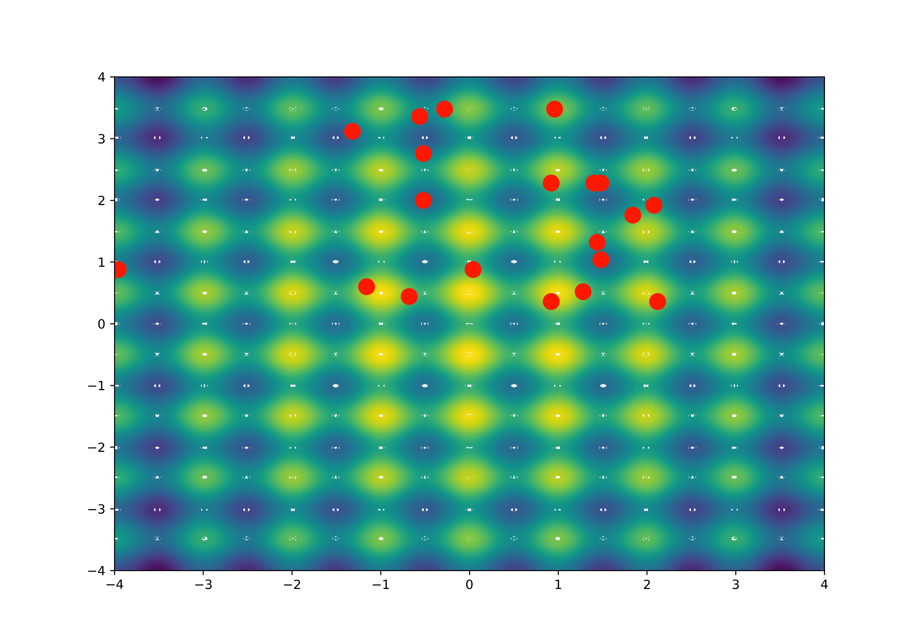
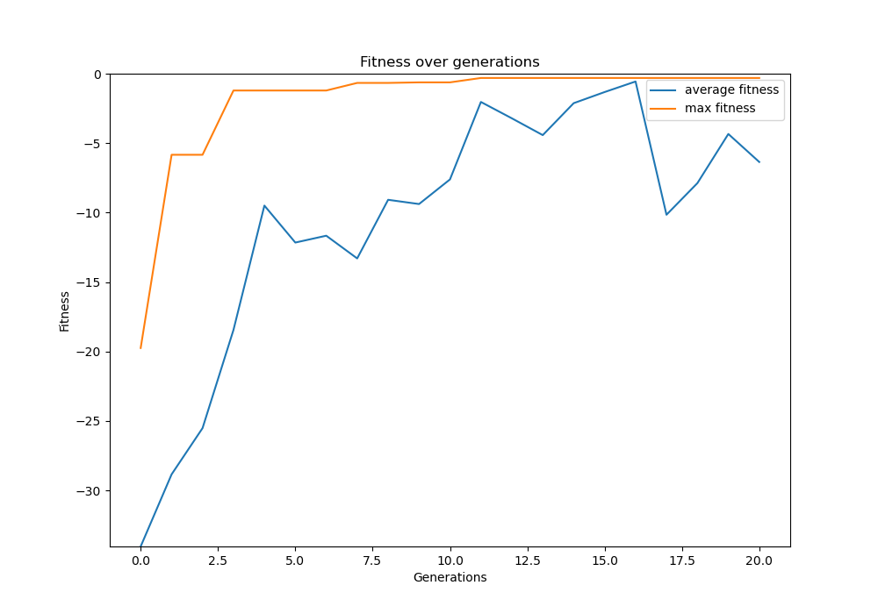
Genetic Algorithm: Rastrigin

